Slide 1


Summary & Tips for Planning the Local GloboDiet Training
INTERNATIONAL AGENCY FOR RESEARCH ON CANCER LYON - FRANCE
e-SMP

Slide 2

Standard Operating Procedures (SOP)
Who and what?
GloboDiet procedure
Special focus
Practise short interview & homework
Time schedule
Agreements
Feedback from the interviewers/respondents
Tips for trainers
IARC, Lyon - France
GloboDiet training:

Slide 3


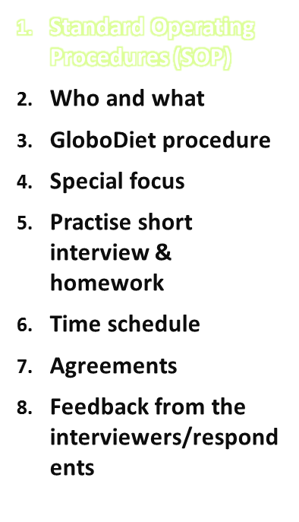
All the training material (including the presentations) is provided by IARC
These training documents are Standard Operating Procedures (SOP) and should not be altered without notifications in order to ensure standardization within and between countries
The copyright for these documents is retained by IARC
More details and tips for the preparation of your Local GloboDiet training are provided in the next slides
Tips for trainers
IARC, Lyon - France
GloboDiet training:

Slide 4
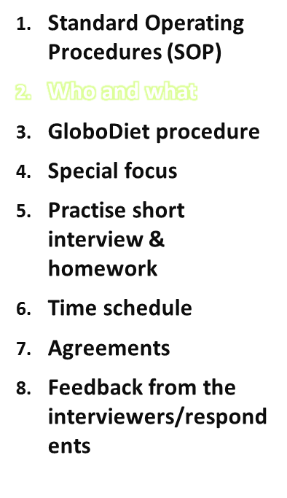
Trainers
Interviewers
Equipment/material
Training program
Reading materials
Country specific exercises + DEMO
Think about planning and logistics of the fieldwork
Tips for trainers
IARC, Lyon - France
GloboDiet training:

Slide 5
The trainer
Requirements:
  Knows all ins & outs of GloboDiet (and related tools and guidelines), preferably has experience with doing interviews with GloboDiet
  Good nutritional knowledge (e.g. dietitian or nutritionist)
  Assisted by IT personnel
If new with GloboDiet:
  Practice a lot
  Read all reading material
TIP: 2nd person to operate GloboDiet
Tips for trainers
IARC, Lyon - France
GloboDiet training:

Slide 6
The trainer
Prior to the training, the trainers should be familiar with:
  Goal(s) of the survey (e.g. surveillance vs. risk assessment)
  Distinction(s) between food and recipe definitions
  Food and recipe classifications
  Meaning/proper use of facets and descriptors
  Quantification methods
  Food, recipe and dietary supplement lists
  GloboDiet installation/uninstallation /interview backup
  GloboDiet interview steps and management of recipes
  Interview techniques
Tips for trainers
IARC, Lyon - France
GloboDiet training:

Slide 7
Interviewers
Requirements:
  Knowledge of local foods and dietary customs
  Familiar with dietary assessment
  Polite and respectful attitude
  -> Preferably dietitians
Think about:
  Planning & logistics (e.g. they should be available on the days of the week that will be recalled, consider the region)
Before working in the field, performing the interviews, the interviewers should
  have attended the GloboDiet training course
  be familiar with GloboDiet, the related tools and guidelines
Tips for trainers
IARC, Lyon - France
GloboDiet training:

Slide 8
Equipment/Material
For the training you might need:
  2 laptops & 1 or 2 beamers/projectors (GloboDiet interview + slide presentation)
  Training agenda
  PowerPoint presentation & handouts
  Reading materials/portfolios (e.g. translated user’s manual and country-specific databases)
  DEMO interview
  PCs/laptops with country-specific GloboDiet (one per interviewer)
  Country-specific picture books, bread shapes, etc.
Tips for trainers
IARC, Lyon - France
GloboDiet training:

Slide 9
Materials
All the materials that are provided during the train-the-trainer session (user manual, slides, etc.) should be translated to the local language
However, contents should remain identical (standardization)!
Country specific examples can be included
All translated materials should be given to the interviewers
Tips for trainers
IARC, Lyon - France
GloboDiet training:

Slide 10
Materials
Documents to be provided to the Interviewers:
Translated GloboDiet user manual with its appendices:
  Appendix 1: Thesaurus of facets and descriptors
    → The national coordinators should be aware of the meaning and implication, links between facets and descriptors
  Appendix 2: Summary of the GloboDiet functions
  Appendix 3: How to install and uninstall GloboDiet
  Appendix 4: Database management in GloboDiet & DataEntry (Interview data and GloboDiet databases)
  Appendix 5: Export guide
Local training course with specific exercises
Classifications of foods and recipes
Country-specific files:
  Food, recipe and DS lists – synonyms/shadows and brands
  List of facets and descriptors used in the project
  Picture booklet with the local quantification methods
Tips for trainers
IARC, Lyon - France
GloboDiet training:

Slide 11
Example Reading Materials
Extra study specific materials can be provided to interviewers. Example Belgium & Netherlands:
  Information for the interviewer (study specific)
  Interview with GloboDiet (user guide)
  Training program
  Study protocol
  Information on the participants (e.g. address, etc.)
  Photo book
  Food list
  Shadow list
  List of facets and descriptors
  Recipe list
Tips for trainers
IARC, Lyon - France
GloboDiet training:

Slide 12
Example Reading Materials
Example Belgium & Netherlands (continued):
  HHM (pictures) & bread shapes
  List of supplements
  Brief list of keyboard functions
  Quick list items
  List of definitions
  Thesaurus on facet/descriptors
  Training handouts
  Exercises
  GloboDiet user manual
  HELP-desk information
Tips for trainers
IARC, Lyon - France
GloboDiet training:

Slide 13
Country Specific Exercises + DEMO
Requirements:
  Exercises to get familiar with the quick list and description part
  Practice to get familiar with the 4 possibilities of handling recipes
  DEMO: to get familiar with interview techniques
  Homework exercise
Tips for trainers
IARC, Lyon - France
GloboDiet training:

Slide 14
Think about planning and logistics fieldwork
Who is in charge of planning the interviews?
Who is in charge of correcting the interviews based on attached note files?
Tips for trainers
IARC, Lyon - France
GloboDiet training:

Slide 15
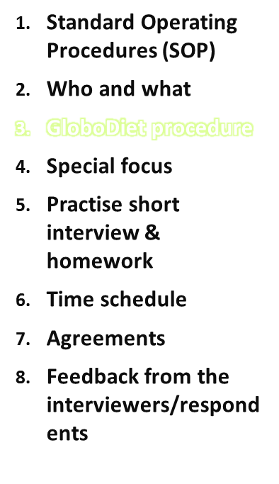
Start new interview in GloboDiet
  Start GloboDiet program
  Demonstrate GloboDiet simultaneously with the slides
Main message:
Start new interview when the respondent is in front of the interviewer, end when the 24-h recall ends (important to remind interviewers that the time/length of the interview recorded depends on the time on which the interviewer opens a new interview)
Tips for trainers
IARC, Lyon - France
GloboDiet training:

Slide 16
General Info
Interviewer/center
Interviewee data
Recalled day and wake-up time
Main message:
The recall asks for all food/drinks consumed between time of waking up yesterday until time of waking up today!
Info about interviewee: the general info will be used in the final quality control
Tips for trainers
IARC, Lyon - France
GloboDiet training:

Slide 17
Quick List
What is a quick list?
Choose FCO
Enter time and place of FCO
Input generic items
How to exit the quick list?
  Main message:
  Quick list should be quick
  Possibility to copy items → saves time
  How to exit quick list
Tips for trainers
IARC, Lyon - France
GloboDiet training:

Slide 18
Description & quantification
Suggested Training Steps
STEP 1: search & identify foods/drinks
STEP 2: description of foods/drinks
STEP 3: quantification of foods/drinks
STEP 4: quality controls
STEP 5: dietary supplements
STEP 6: recipe pathways
Tips for trainers
IARC, Lyon - France
GloboDiet training:

Slide 19
STEP 1: search & identification
Select quick list item
Search in food list
DEMO search options
Main message:
Train the way/methods and speed of searching → saves time
Tips for trainers
IARC, Lyon - France
GloboDiet training:

Slide 20
STEP 2: description
Facets/descriptors
Questions automatically appear on the screen
Main message:
Study the Thesaurus with definitions
Tips for trainers
IARC, Lyon - France
GloboDiet training:

Slide 21
STEP 3: quantification
Explain the quantification methods to choose from
DEMO quantification
Explain the association table (when does it appear?)
DEMO association table
Main message:
Choice for quantification method has to be made by the respondent
Tips for trainers
IARC, Lyon - France
GloboDiet training:

Slide 22
STEP 4: quality controls
Explain which quality controls are done during the interview and at the end of the interview*
*Local coordinator and trainer can read the paper from Crispim S. (2013):
Crispim SP, Nicolas G, Casagrande C, Knaze V, Illner AK, Huybrechts I, Slimani N.
Quality assurance of the international computerised 24 h dietary recall method (EPIC-Soft). Br J Nutr. 2014 Feb;111(3):506-15. doi: 10.1017/S0007114513002766.
Tips for trainers
IARC, Lyon - France
GloboDiet training:

Slide 23
STEP 5: dietary supplements
Explain and DEMOnstrate the question on supplements
Note: this involves recording the supplement use on the day of recall
Main message:
Save and exit the interview to make sure the time (duration interview is stopped)
Tips for trainers
IARC, Lyon - France
GloboDiet training:

Slide 24
STEP 6: recipe pathways
Explain and DEMOnstrate the recipe pathways
Note: make sure that the interviewers know what food groups that are included in the recipe list compared to the food list (e.g. pay attention to soups, sauces, etc. that might differ between surveys).
Main message:
underline the difference between the different recipe pathways (e.g. commercial recipe, etc.)
Tips for trainers
IARC, Lyon - France
GloboDiet training:

Slide 25
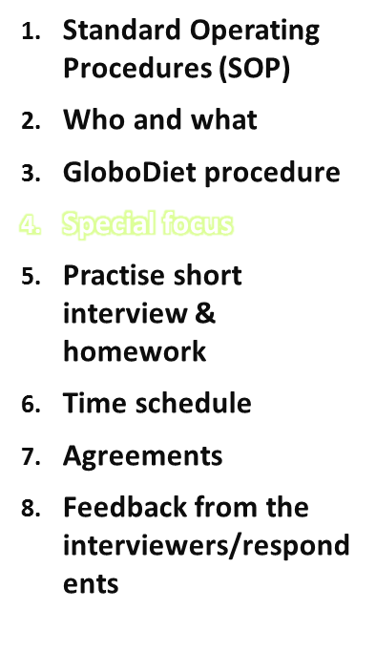
Special focus on …
Identification
Description
Quantification
Notes
Interview techniques
Recipes
Tips for trainers
IARC, Lyon - France
GloboDiet training:

Slide 26
Special focus on identification
Identification → food list
Interviewers should be familiar with the food list
  Nomenclature used in the food list
  How to enter a new food
  N.s.-items → when and how to use them
  DEMO new food
Tips for trainers
IARC, Lyon - France
GloboDiet training:

Slide 27
Special focus on description
Description → facets
Some descriptions need extra training: DEMO
Facet fat used: the order of fats is different from the food list, instruction use of commercial fat
Facet Brand names:
  Predefined list at subgroups level
  New brand names can be entered as well
Tips for trainers
IARC, Lyon - France
GloboDiet training:

Slide 28
Special focus on quantification
Some quantifications need extra training: DEMO
  Household meausures
  Photos
  Ruler
  Breadshapes
  Volume
  Weight
  The quantity for a cooked food can be entered as cooked weight or raw, this influences the calculated consumed weight
  Point of interest
  Cooking method descriptor is “not applicable”
  If “raw” weight is entered →GloboDiet automatically applicates a raw-cook coefficient
Tips for trainers
IARC, Lyon - France
GloboDiet training:

Slide 29
Special focus on recipes
Main message: Interviewer should be familiar with the different ways to handle recipes
Points of interest:
  Structured
  How to handle recipes → give tips
  Choices → it is preferable to use a recipe from the list and alter it, because of quantification of ingredients
Exercise specifically on recipes
Different kinds of recipes:
  Fixed recipe
  Recipe with substitution
  Adapt a recipe from the list
  New recipe
Tips for trainers
IARC, Lyon - France
GloboDiet training:

Slide 30
Special focus on ‘notes’
Main message:
  Description of ‘notes’: short & structured
  Explain in detail how to record notes & show them how ‘notes’ are being handled post-interview → day 1 and day 2 of the training
Experience: sometimes hard to take a decision during the interview and a lot of information is typed in the notes → takes much time in processing the notes afterwards
Tips for trainers
IARC, Lyon - France
GloboDiet training:

Slide 31
Special focus on interview techniques
DEMO short interview
Points of interest
  Interview techniques: how to ask questions and role of the interviewer
  Emphasise that foods to probe and description facets will automatically appear on the screen → all those questions should be addressed
  Exercise!
Tips for trainers
IARC, Lyon - France
GloboDiet training:

Slide 32
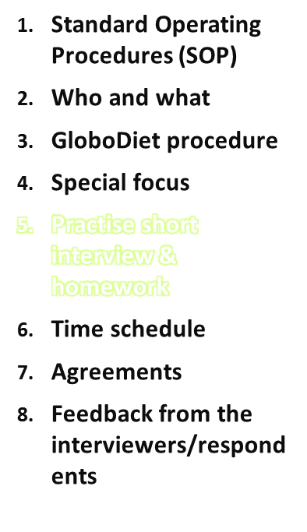
Practise a short interview
On the first training day, the interviewers can practise a short interview to get started or at least practise inputting foods
On the second day you can do this again to see whether they are ready to start interviewing real participants included in the study
Interviewers can also interview each other
Tips for trainers
IARC, Lyon - France
GloboDiet training:

Slide 33
Exercise homework
To get proficient with GloboDiet appl.
To get familiar with all screens
To know the function keys & mouse options
To find foods easily
To get familiar with the interview techniques
Discuss them on day 2 of the training
Tips for trainers
IARC, Lyon - France
GloboDiet training:

Slide 34
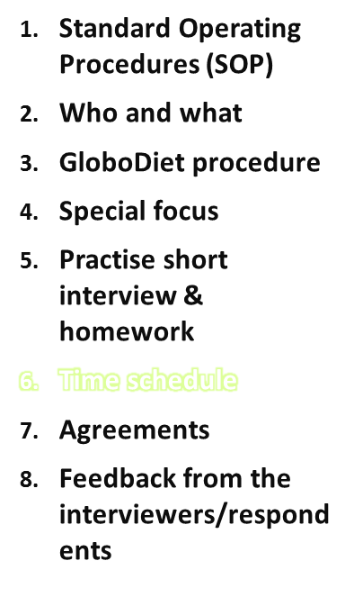
Minimum Time Schedule
Preferebly 3 full training days:
  1st day: focus on general concepts, interview techniques and basic exercises
  2nd day: focus on recipes and more advanced exercises
  3rd day (1 week after 2nd day): discuss and correct homework, explain interview manager and IT issues (like backup system etc.).
  The afternoon on the 3rd training day can be used to explain extra fieldwork issues (e.g. extra questionnaires, etc.)
Tips for trainers
IARC, Lyon - France
GloboDiet training:

Slide 35

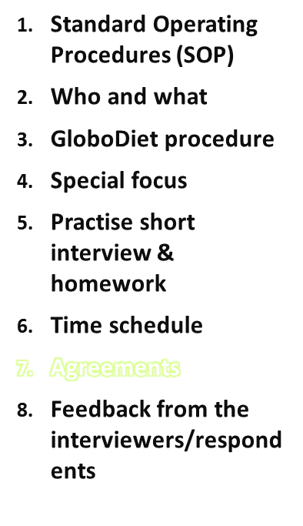
Outline
Agreements
Inform the interviewers HOW, TO WHOM & WHEN they can ask questions during their homework between 1st and 2nd training day
Interviewers should sign the contracts for use of the materials (laptop, etc.) prior to obtaining them. Make sure that the serial number is included in the contract!
Explain the policies for the use of all the materials well (and in case of loss)
What to do when interview gets lost (e.g. pc crash/stolen)? New appointment to be made?
BACKUPS!!!
Tips for trainers
IARC, Lyon - France
GloboDiet training:

Slide 36
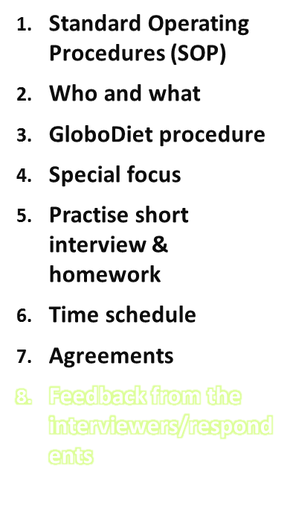
Feedback from the interviewers/respondents
Inform the interviewers about the hierarchical structure, the communication modes between the coordinating center and the interviewers and the follow-up of the interviewers
HELP-desk information
Interviewer feedback/return day
Inform interviewers about quality control procedures of the interviews/interviewers by coordinator
Tips for trainers
IARC, Lyon - France
GloboDiet training:

Slide 37
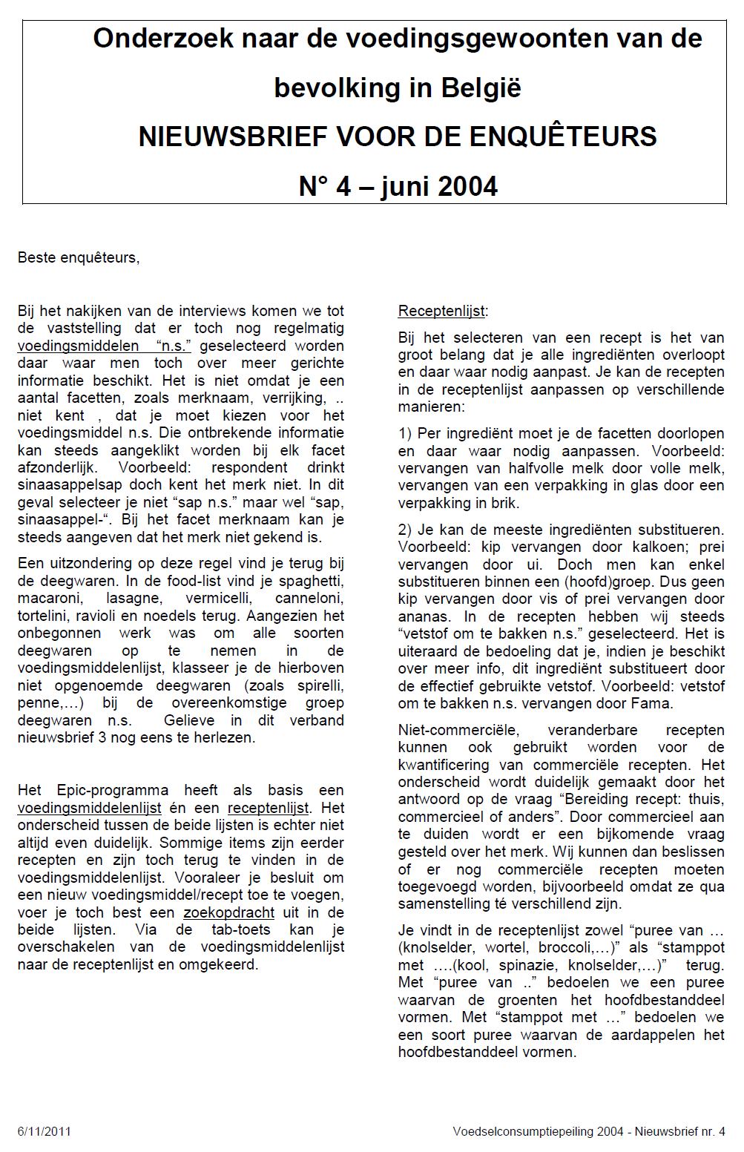
Newsletter for interviewers
Tips for trainers
IARC, Lyon - France
GloboDiet training:

Slide 38
Tips & Warnings
Include local examples in your training (e.g. local recipes)!
The trainers need to have a thorough understanding of possible problems and should pay attention to the local/cultural eating habits when considering cooking methods …
Tips for trainers
IARC, Lyon - France
GloboDiet training:

Slide 39
Tips & Warnings
Recruitment of interviewers (reserve list?)
Interviewer contracts (salary, conditions etc.) can influence drop-out of interviewers
Payment/costs for training day/homework
Have a strategy to handle drop-outs?
How to train reserve interviewers?
  Together with the interviewers
  Only if interviewers withdraw
Tips for trainers
IARC, Lyon - France
GloboDiet training:

Slide 40

Acknowledgements
Tips for trainers
IARC, Lyon - France
GloboDiet training:

